Slide 1

Galaxies Tutorial II
Lecturer: "Schiavon, Ricardo" R.P.Schiavon@ljmu.ac.uk Tutorial Assistant: Alex Hill <A.D.Hill@2017.ljmu.ac.uk>

Slide 2
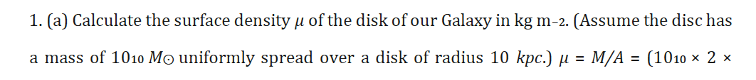
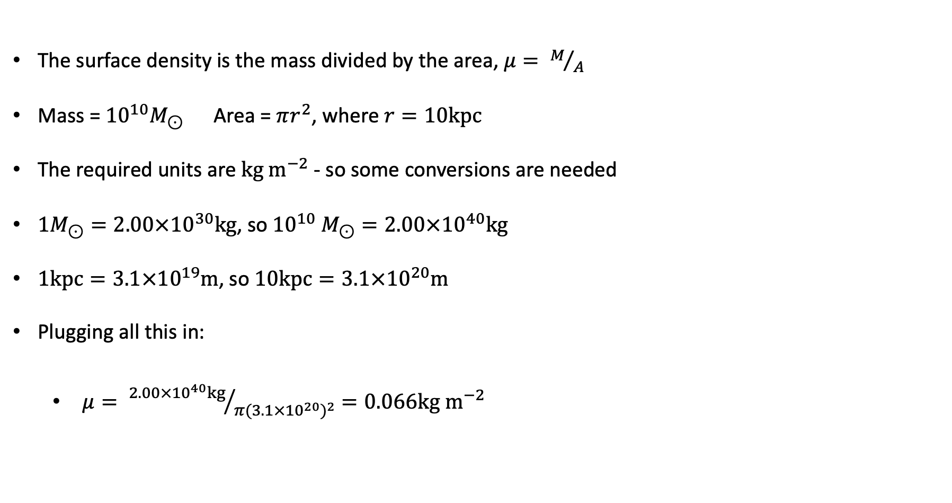
The surface density is the mass divided by the area, $μ= M/A$
Mass = ${10}^{10}M_{⊙}$ Area = $πr^{2}$, where $r=10kpc$
The required units are $kg m^{−2}$ - so some conversions are needed
$1M_{⊙}=2.00×{10}^{30}kg$, so ${10}^{10} M_{⊙}=2.00×{10}^{40}kg$
$1kpc=3.1×{10}^{19}m$, so $10kpc=3.1×{10}^{20}m$
Plugging all this in:
$μ= {2.00×{10}^{40}kg}/{π{(3.1×{10}^{20})}^{2}}=0.066kg m^{−2}$

Slide 3
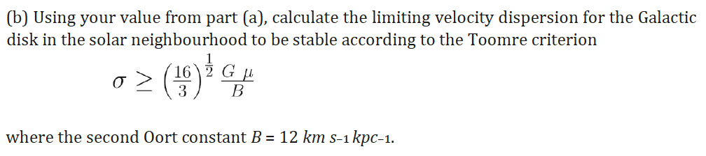
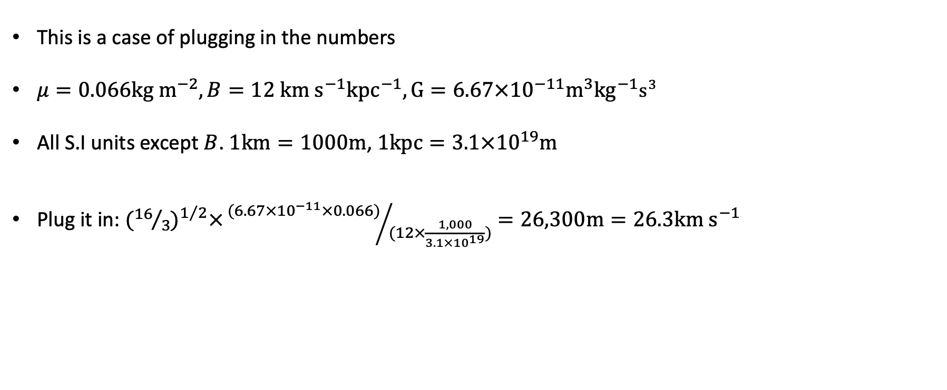
This is a case of plugging in the numbers
$μ=0.066kg m^{−2}, B=12 km s^{−1}{kpc}^{−1}, G=6.67×{10}^{−11}m^{3}{kg}^{−1}s^{3}$
All S.I units except $B$. $1km=1000m$, $1kpc=3.1×{10}^{19}m$
Plug it in: ${({16}/3)}^{1/2}×{(6.67×{10}^{−11}×0.066)}/{(12×\frac{1,000}{3.1×{10}^{19}})}=26,300m=26.3km s^{−1}$

Slide 4
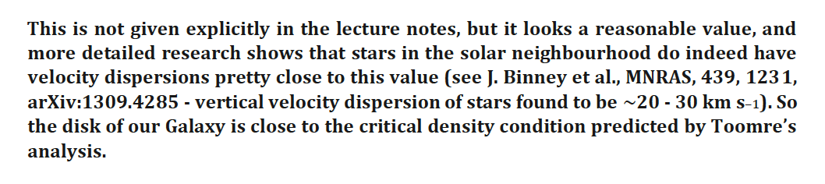

Slide 5
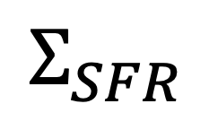
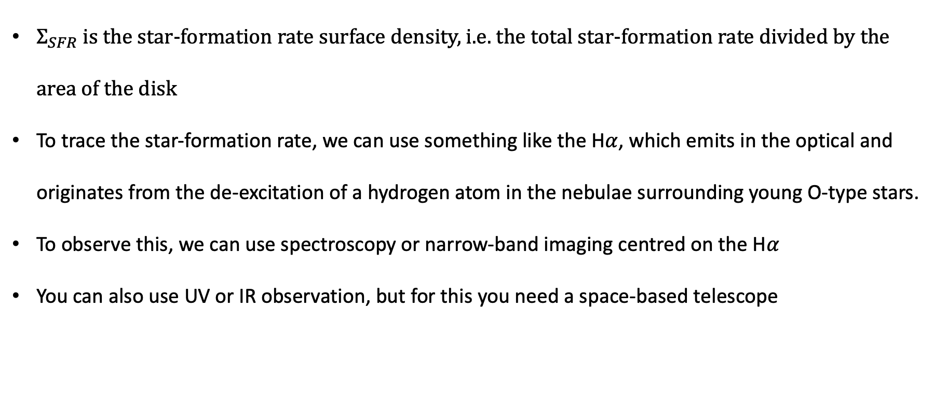
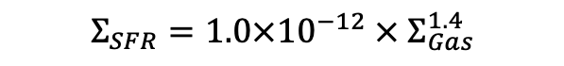
$$Σ_{SFR}=1.0×{10}^{−12} × Σ_{Gas}^{1.4}$$
$$Σ_{SFR}$$
$Σ_{SFR}$ is the star-formation rate surface density, i.e. the total star-formation rate divided by the area of the disk
To trace the star-formation rate, we can use something like the H$α$, which emits in the optical and originates from the de-excitation of a hydrogen atom in the nebulae surrounding young O-type stars.
To observe this, we can use spectroscopy or narrow-band imaging centred on the H$α$
You can also use UV or IR observation, but for this you need a space-based telescope

Slide 6
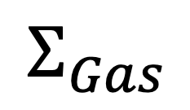
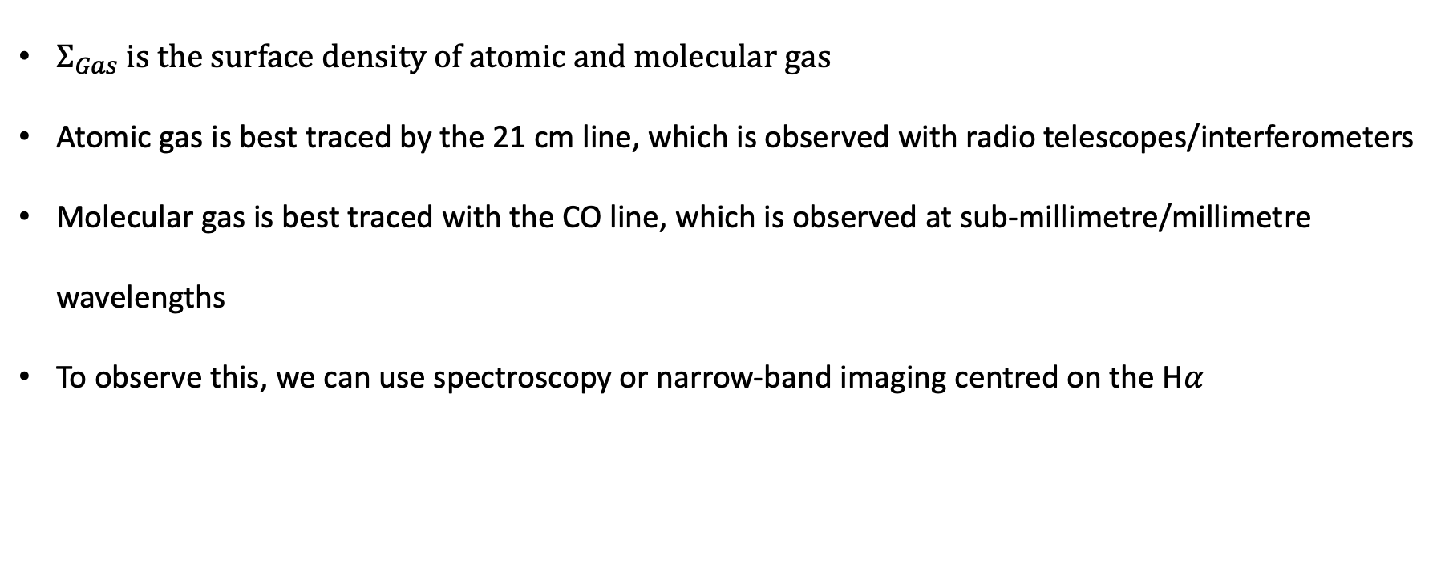
$$Σ_{SFR}=1.0×{10}^{−12} × Σ_{Gas}^{1.4}$$
$$Σ_{Gas}$$
$Σ_{Gas}$ is the surface density of atomic and molecular gas
Atomic gas is best traced by the 21 cm line, which is observed with radio telescopes/interferometers
Molecular gas is best traced with the CO line, which is observed at sub-millimetre/millimetre wavelengths
To observe this, we can use spectroscopy or narrow-band imaging centred on the H$α$

Slide 7
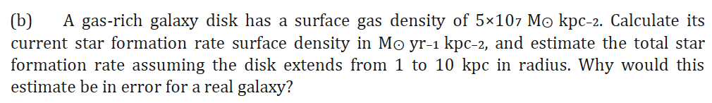
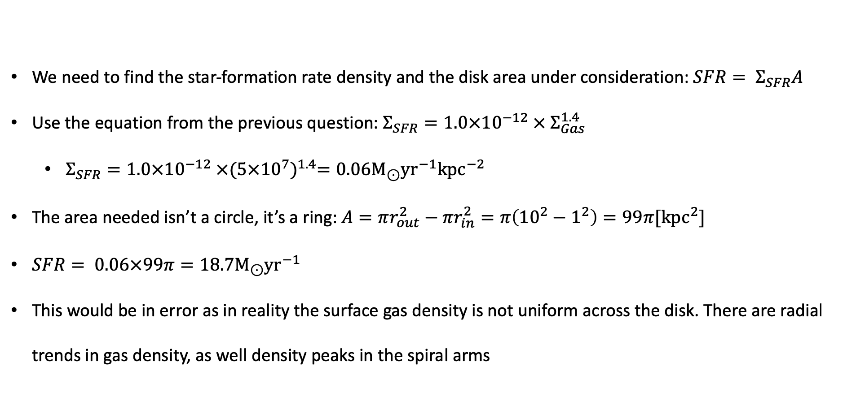
We need to find the star-formation rate density and the disk area under consideration: ${SFR= Σ}_{SFR}A$
Use the equation from the previous question: $Σ_{SFR}=1.0×{10}^{−12} × Σ_{Gas}^{1.4}$
$Σ_{SFR}=1.0×{10}^{−12} ×{(5×{10}^{7})}^{1.4}=0.06M_{⊙}{yr}^{−1}{kpc}^{−2}$
The area needed isn’t a circle, it’s a ring: $A=πr_{out}^{2}−{πr}_{in}^{2}=π\left({10}^{2}−1^{2}\right)=99π[{kpc}^{2}]$
$SFR= 0.06×99π=18.7M_{⊙}{yr}^{−1}$
This would be in error as in reality the surface gas density is not uniform across the disk. There are radial trends in gas density, as well density peaks in the spiral arms

Slide 8
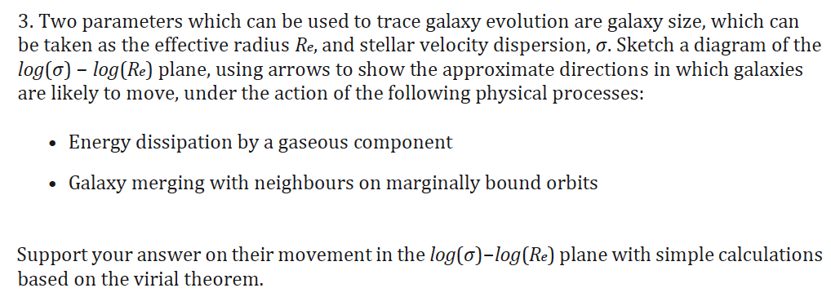

Slide 9
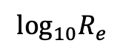
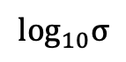
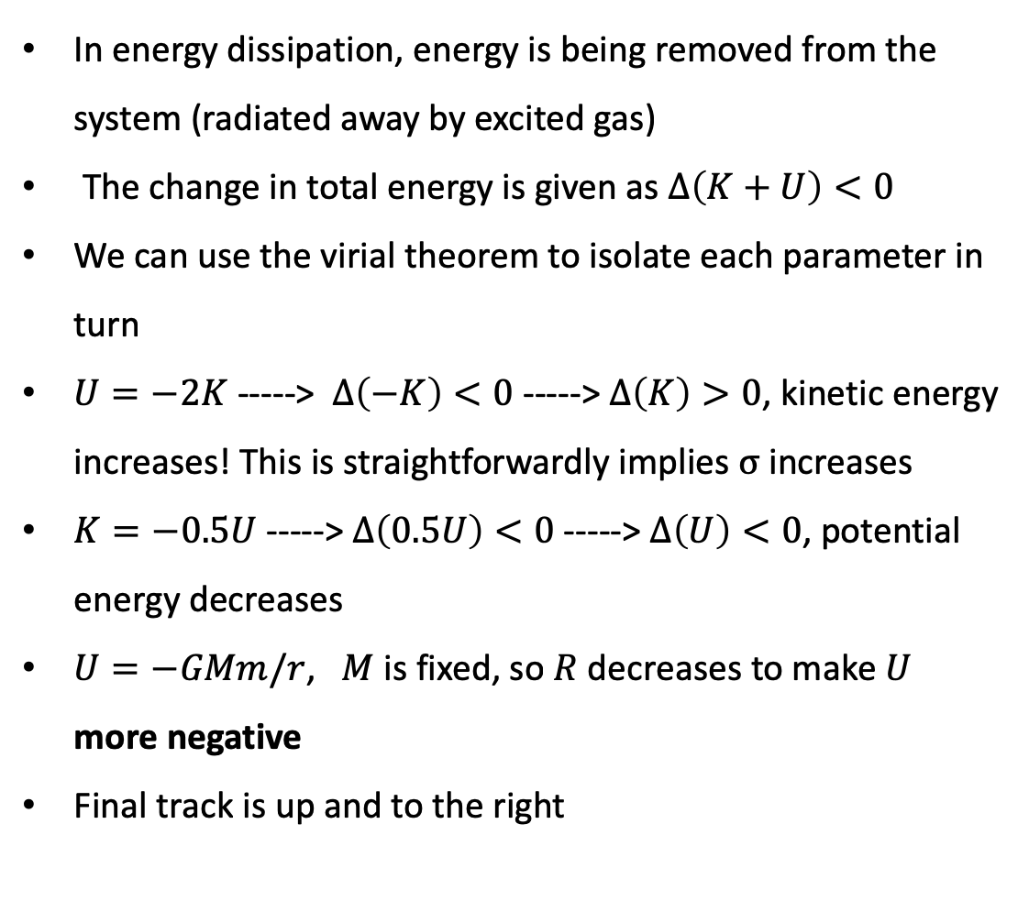
The virial theorem is that a virialised system obeys $2K+U=0$, where $K$ and $U$ are the kinetic and gravitational potential energies
In energy dissipation, energy is being removed from the system (radiated away by excited gas)
The change in total energy is given as $∆\left(K+U\right)<0$
We can use the virial theorem to isolate each parameter in turn
$U=−2K$ -----> $∆\left(−K\right)<0$ -----> $∆\left(K\right)>0$, kinetic energy increases! This is straightforwardly implies $σ$ increases
$K=−0.5U$-----> $∆\left(0.5U\right)<0$ -----> $∆\left(U\right)<0$, potential energy decreases
$U=−GMm/r$, $M$ is fixed, so $R$ decreases to make $U$ more negative
Final track is up and to the right
$$\log_{10}σ$$
$$\log_{10}R_{e}$$

Slide 10
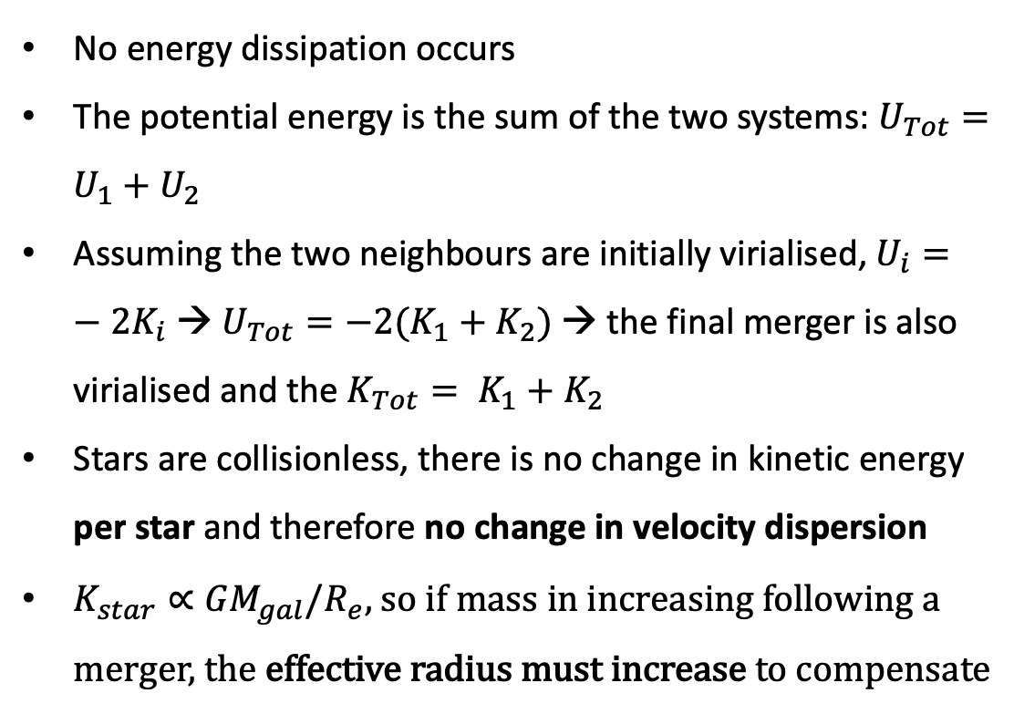
Galaxies merging on just-bound orbits undergo violent relaxation: the stars move into a strongly varying potential
No energy dissipation occurs
The potential energy is the sum of the two systems: $U_{Tot}=U_{1}+U_{2}$
Assuming the two neighbours are initially virialised, $U_{i}=−{2K}_{i}$ → $U_{Tot}={−2(K}_{1}+K_{2})$ → the final merger is also virialised and the $K_{Tot}= K_{1}+K_{2}$
Stars are collisionless, there is no change in kinetic energy per star and therefore no change in velocity dispersion
$K_{star}∝{GM}_{gal}/R_{e}$, so if mass in increasing following a merger, the effective radius must increase to compensate
$$\log_{10}σ$$
$$\log_{10}R_{e}$$

Slide 11
Let’s populate this graph…
To get from a dwarf spheroidal to an elliptical, we need to increase the velocity dispersion and the effective radius
To increase dispersion, we need gas dissipation
This requires gas, so as dwarf spheroids are gas-poor, the dispersion following a merger will stay the same
No!
$$\log_{10}σ$$
Ellipticals
Spirals
Dwarfs
dSph
$$\log_{10}R_{e}$$

Slide 12
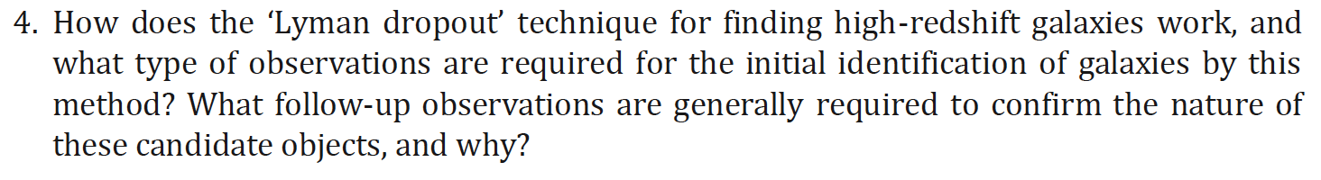
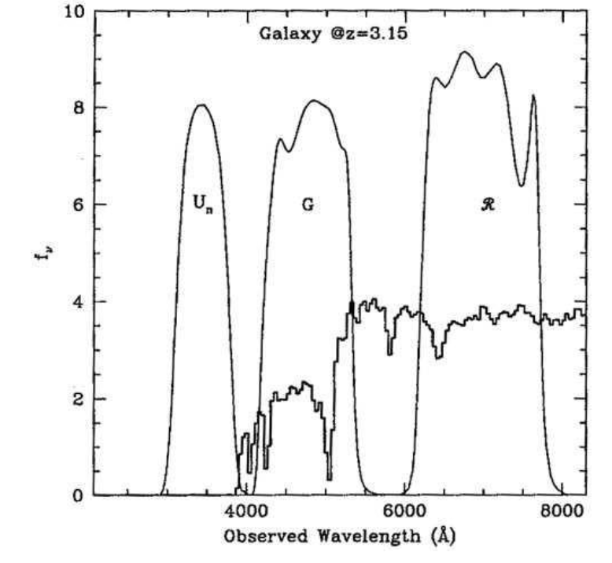
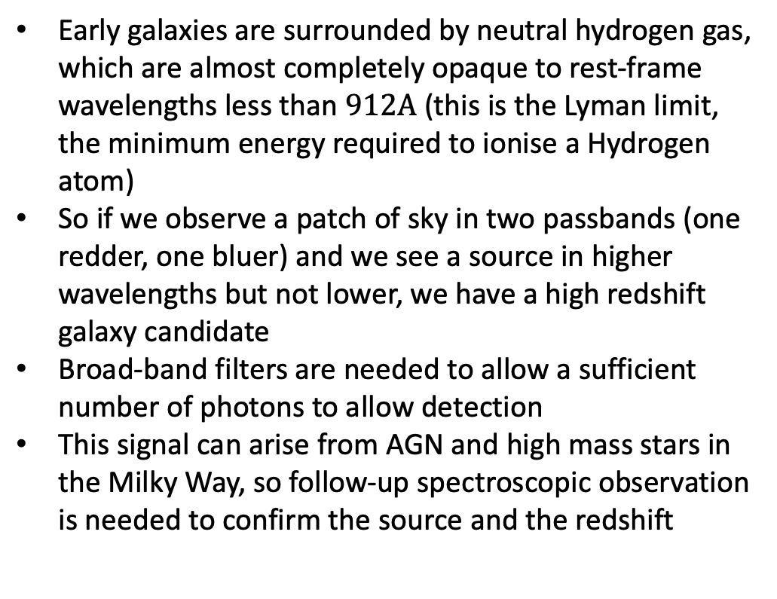
Early galaxies are surrounded by neutral hydrogen gas, which are almost completely opaque to rest-frame wavelengths less than $912A$ (this is the Lyman limit, the minimum energy required to ionise a Hydrogen atom)
So if we observe a patch of sky in two passbands (one redder, one bluer) and we see a source in higher wavelengths but not lower, we have a high redshift galaxy candidate
Broad-band filters are needed to allow a sufficient number of photons to allow detection
This signal can arise from AGN and high mass stars in the Milky Way, so follow-up spectroscopic observation is needed to confirm the source and the redshift

Slide 13
Early galaxies are surrounded by neutral hydrogen gas, which are almost completely opaque to rest-frame wavelengths less than $912A$ (this is the Lyman limit, the minimum energy required to ionise a Hydrogen atom)
So if we observe a patch of sky in two passbands (one redder, one bluer) and we see a source in higher wavelengths but not lower, we have a high redshift galaxy candidate
Broad-band filters are needed to allow a sufficient number of photons to allow detection
This signal can arise from AGN and high mass stars in the Milky Way, so follow-up spectroscopic observation is needed to confirm the source and the redshift

Slide 14
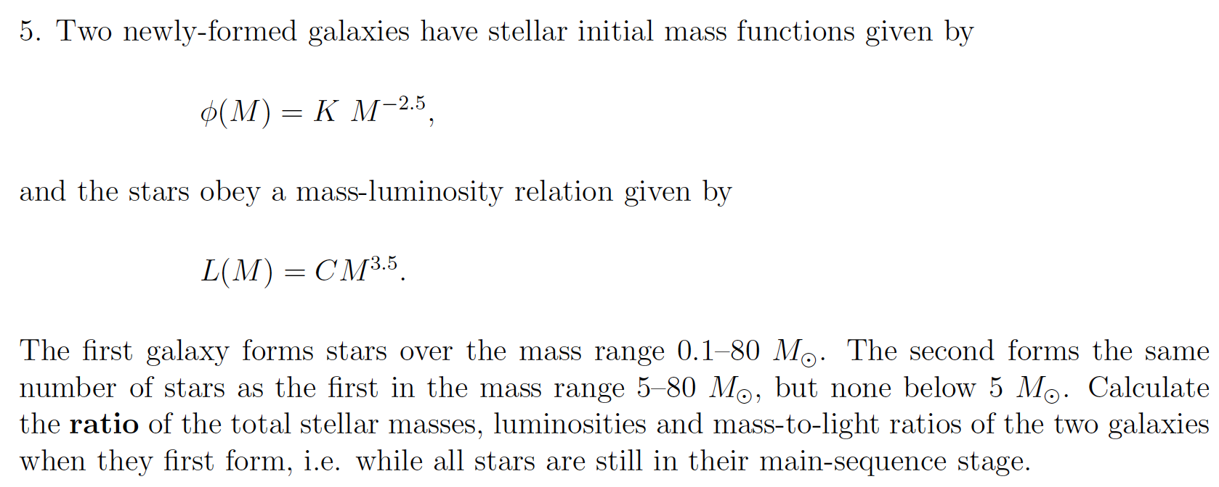
We need a few extra equations in our toolbox here

Slide 15
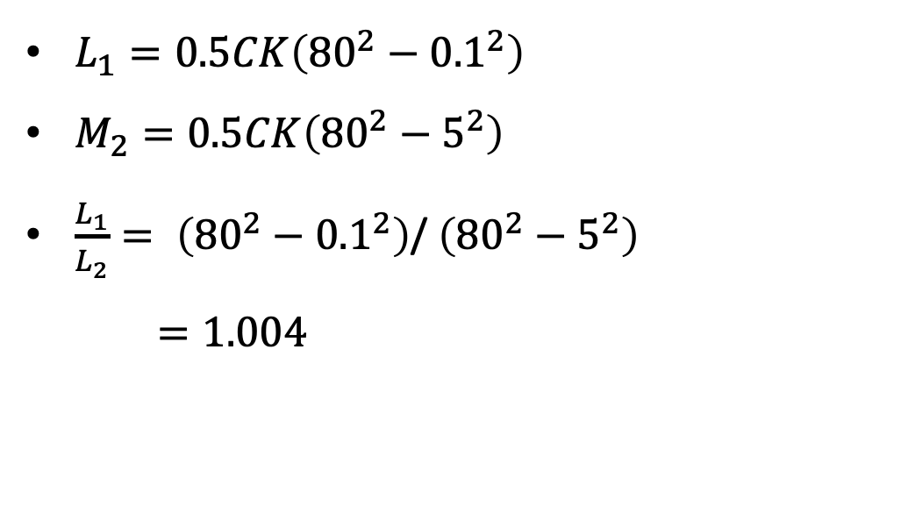
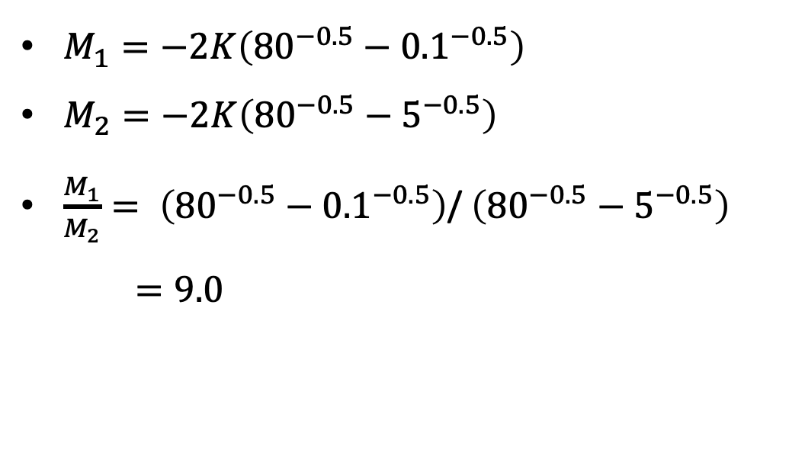
$M_{1}=−2K\left({80}^{−0.5}−{0.1}^{−0.5}\right)$
$M_{2}=−2K\left({80}^{−0.5}−5^{−0.5}\right)$
$\frac{M_{1}}{M_{2}}= \left({80}^{−0.5}−{0.1}^{−0.5}\right)$/ $\left({80}^{−0.5}−5^{−0.5}\right)$
$=9.0$
$L_{1}=0.5CK\left({80}^{2}−{0.1}^{2}\right)$
$M_{2}=0.5CK\left({80}^{2}−5^{2}\right)$
$\frac{L_{1}}{L_{2}}= \left({80}^{2}−{0.1}^{2}\right)$/ $\left({80}^{2}−5^{2}\right)$
$=1.004$

Slide 16
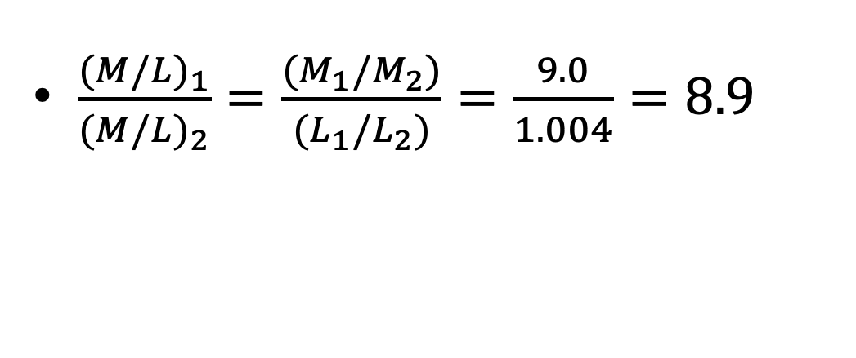
$\frac{{(M/L)}_{1}}{{(M/L)}_{2}}=\frac{(M_{1}/M_{2})}{(L_{1}/L_{2})}=\frac{9.0}{1.004}=8.9$

